Slide 1
Chapter 26
SMTP
and
FTP

Slide 2
26.1 Electronic Mail
Sending/Receiving Mail
Addresses
User Agent
MIME
Mail Transfer Agent
Mail Access Protocols

Slide 3
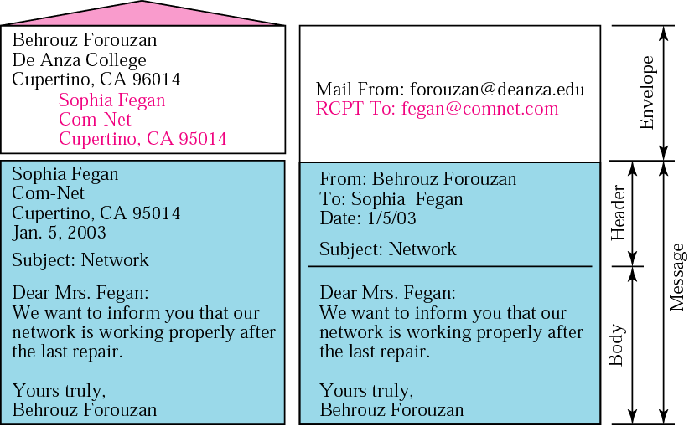
Figure 26.1 Format of an email

Slide 4
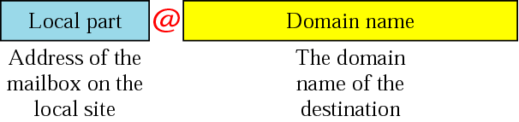
Figure 26.2 Email address

Slide 5
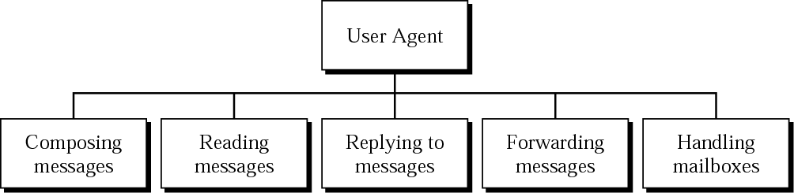
Figure 26.3 User agent

Slide 6

Note:
Some examples of command-driven user agents are mail, pine, and elm.

Slide 7
Note:
Some examples of GUI-based user agents are Eudora, Outlook, and Netscape.

Slide 8
MIME (Multipurpose Internet Mail Extensions)
SMTP (Simple Mail Transfer Protocol)는 오직 7-bit ASCII 형식만 전송 가능
  Extended (혹은 Enhanced) SMTP는 8bit도 가능하지만, 호환성 문제
  초기에 e-mail은 text만을 생각했기 때문
그렇다면 7-bit로 표현할 수 없는 데이터는 어떻게 전송?
  예: 한국어, 중국어, 프랑스어 등은?
  비디오, 오디오 데이터 등은?
그래서 MIME이 생겨남
  MIME은 SMTP를 대치하는 것이 아니라 보완하는 것!

Slide 9
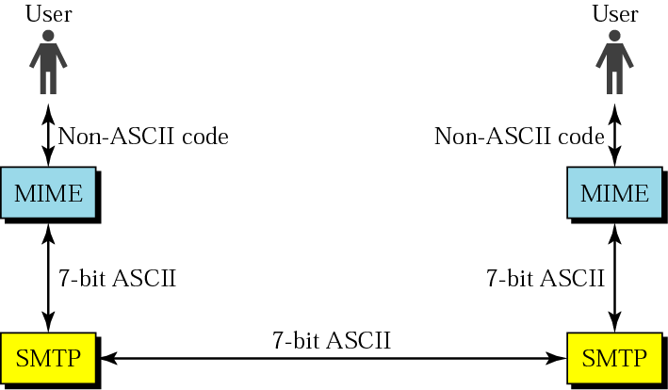
Figure 26.4 MIME

Slide 10
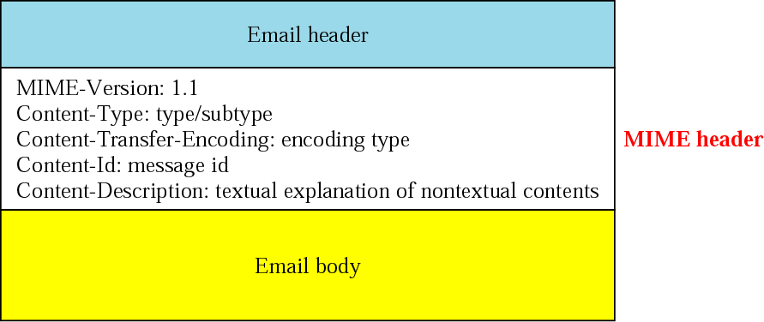
Figure 26.5 MIME header
메일 내용을 알아야 적절한 응용 프로그램에게 맡길 수 있음
7-bit로 변환 방법

Slide 11
Table 26.1 Data types and subtypes in MIME
Type | Subtype | Description
Text | Plain | Unformatted text
Multiport | Mixed | Body contains ordered parts of different data types
 | Parallel | Same as above, but no order
 | Digest | Similar to mixed, but the default is message/RFC822
 | Alternative | Parts are different versions of the same message
Message | RFC822 | Body is an encapsulated message
 | Partial | Body is a fragment of a bigger message
 | Ext. Body | Body is a reference to another message
Image | JPEG | Image is in JPEG
 | GIF | Video is in GIF format
Video | MPEG | Video is in MPEG format
Audio | Basic | Single-channel encoding of voice at 8 KHz
Application | PostScript | Adobe PostScript
 | Octet-Stream | General binary data (8-bit bytes)

Slide 12
Table 26.2 Content-transfer encoding
Category | Description
7bit | ASCII characters and short lines
8bit | Non-ASCII characters and short lines
Binary | Non-ASCII characters with unlimited-length lines
Base64 | 6-bit blocks of data are encoded into 8-bit ASCII characters
Quoted-printable | Non-ASCII characters are encoded as an equal sign followed by an ASCII code
SMTP에 사용할 수 없음 (내용이 7-bit encoding이 아니기 때문)

Slide 13
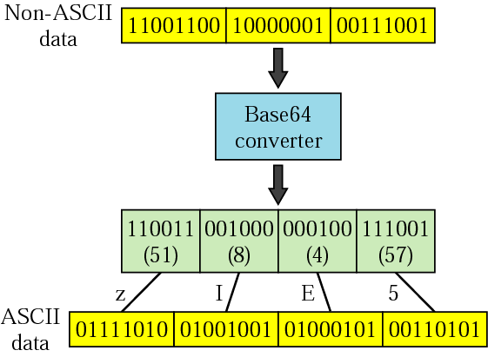
Figure 26. 6 Base64
8비트 코드 3개
(24비트)
6비트 코드 4개
8비트 코드 4개
(32비트)
결과적으로 24비트가 32비트로 변환됨
즉, 32/24=1.33이므로 33% 오버헤드 발생

Slide 14
Table 26.3 Base64 encoding table
Value | Code | Value | Code | Value | Code | Value | Code | Value | Code | Value | Code
0 | A | 11 | L | 22 | W | 33 | h | 44 | s | 55 | 3
1 | B | 12 | M | 23 | X | 34 | i | 45 | t | 56 | 4
2 | C | 13 | N | 24 | Y | 35 | j | 46 | u | 57 | 5
3 | D | 14 | O | 25 | Z | 36 | k | 47 | v | 58 | 6
4 | E | 15 | P | 26 | a | 37 | l | 48 | w | 59 | 7
5 | F | 16 | Q | 27 | b | 38 | m | 49 | x | 60 | 8
6 | G | 17 | R | 28 | c | 39 | n | 50 | y | 61 | 9
7 | H | 18 | S | 29 | d | 40 | o | 51 | z | 62 | +
8 | I | 19 | T | 30 | e | 41 | p | 52 | 0 | 63 | /
9 | J | 20 | U | 31 | f | 42 | q | 53 | 1
10 | K | 21 | V | 32 | g | 43 | r | 54 | 2

Slide 15
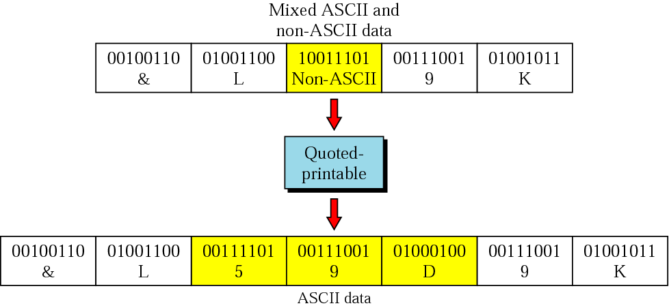
Figure 26.7 Quoted-printable
Non-ASCII 데이터, 즉 상위 비트가 1인 바이트만
3바이트로 변환 ( ‘=‘, 16진수 값의 ASCII 값)
상위 비트가 1
16진수로 표현하면 9D
‘=‘의 ASCII 값
‘9‘의 ASCII 값
‘D‘의 ASCII 값
전체 데이터 중 Non-ASCII 데이터의 비율이 작을 때
Base64 encoding보다 효율적임

Slide 16
E-mail을 전달하기
E-mail의 실제 전달은 MTA (Mail Transfer Agent)가 맡음
  예: UNIX의 경우 sendmail daemon 프로그램
  메일을 보내기 위해서는 MTA client가 필요
  메일을 수신하기 위해서는 MTA server가 필요
  MTA client와 MTA server는 SMTP 사용

Slide 17
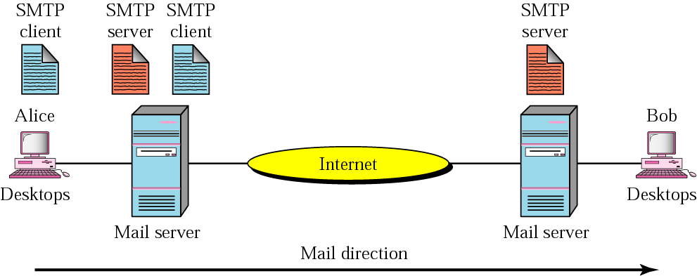
Figure 26.8 MTA client and server
1st stage
(SMTP)
2nd stage
(SMTP)
3rd stage
(No SMTP)
SMTP
client or
server

Slide 18
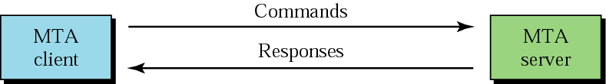
Figure 26.9 Commands and responses
Connection establishment (TCP 연결)
HELO, MAIL, RCPT, …
3글자의 숫자+부가 정보
Connection termination (TCP 종료)

Slide 19
예:
MTA server포트는 25번
telnet을 이용하여 25번 포트에 TCP 연결
키보드로 치는 것을 전송함
telnet에서 CTRL-D를 누르면 TCP 종료
telnet www.example.com 25
서버 응답
S: 220 www.example.com ESMTP Postfix
C: HELO mydomain.com
S: 250 Hello mydomain.com
C: MAIL FROM:<sender@mydomain.com>
S: 250 Ok
C: RCPT TO:<friend@example.com>
S: 250 Ok
C: DATA
S: 354 End data with <CR><LF>.<CR><LF>
C: Subject: test message
C: From: sender@mydomain.com
C: To: friend@example.com
C:
C: Hello,
C: This is a test.
C: Goodbye.
C: .
S: 250 Ok: queued as 12345
C: QUIT
S: 221 Bye
Client

Slide 20
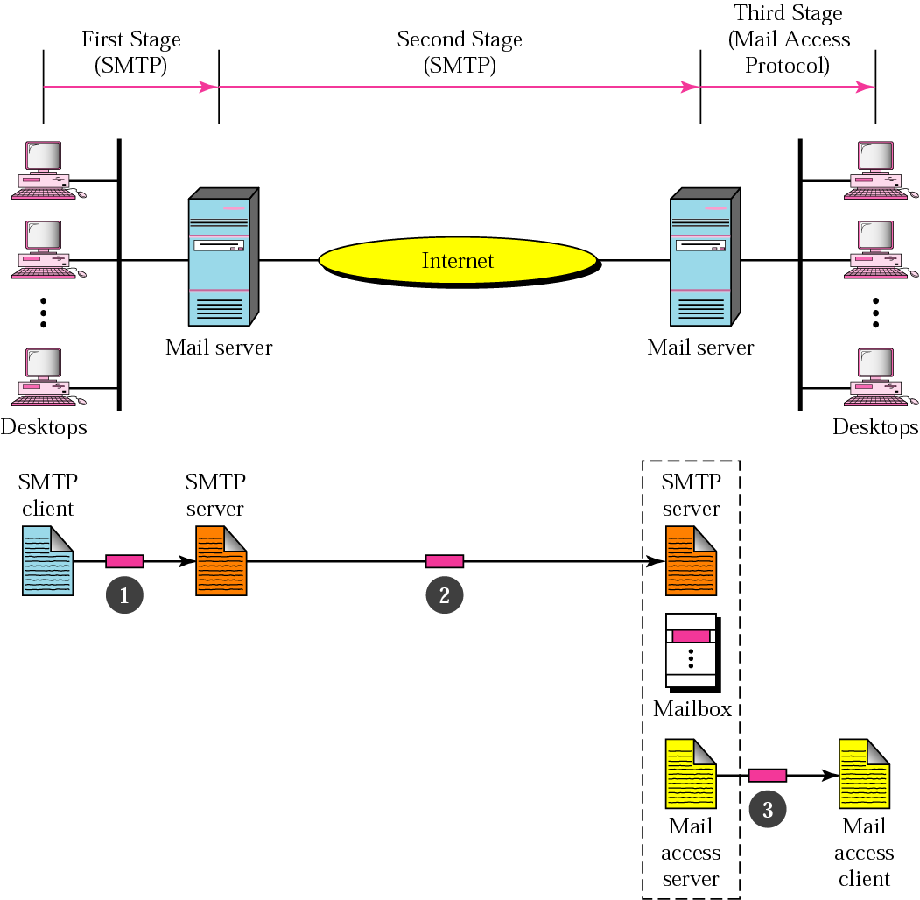
Figure 26.10 Email delivery
SMTP (a PUSH protocol)
A Pull protocol
(e.g., POP3, IMAP4)

Slide 21
Mail access protocols
POP3 (Post Office Protocol version 3)
IMAP4 (Internet Mail Access Protocol version 4)
Web-based Mail
  Yahoo나 gmail 등
  웹 브라우져 (IE, netscape)로 HTTP를 이용
    주) sending mail server에서 receiving mail server까지는 SMTP 사용

Slide 22
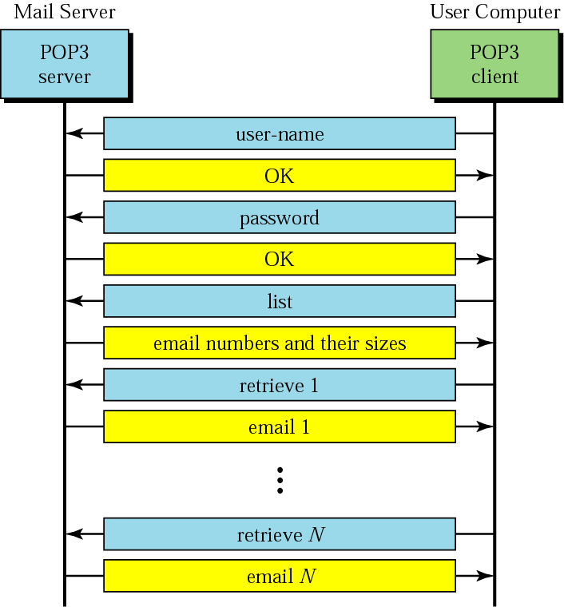
Figure 26.11 POP3 (Post Office Protocol, version 3)

Slide 23
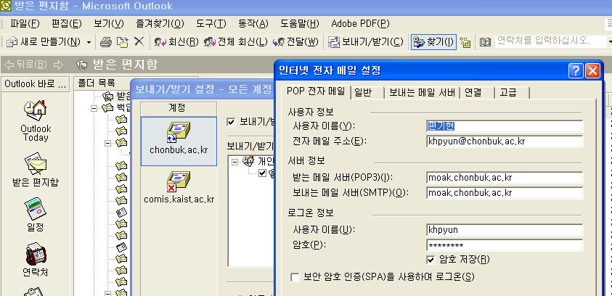
POP3 사용 예

Slide 24
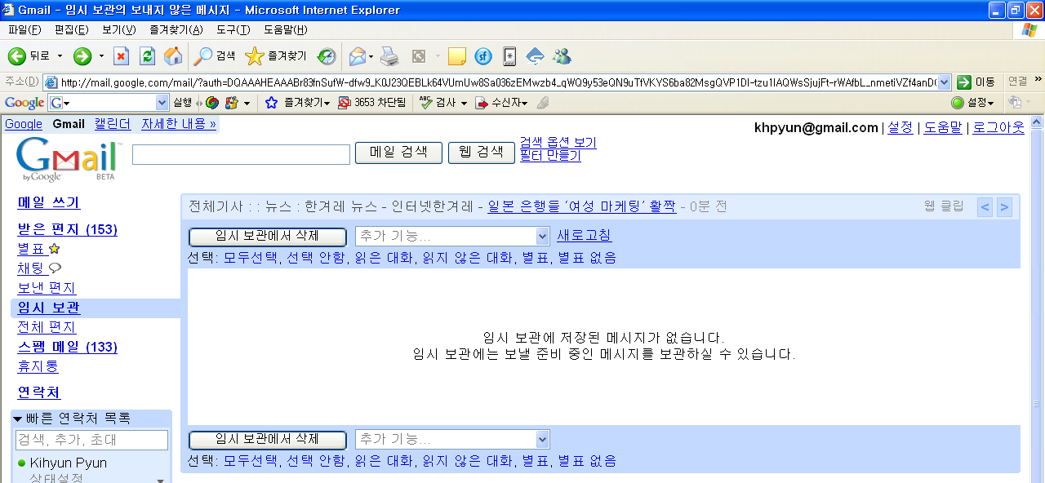
Web-based Mail 사용 예

Slide 25
26.2 File Transfer
Connections
Communication
File Transfer
User Interface
Anonymous

Slide 26
Note:
FTP uses the services of TCP. It needs two TCP connections. The well-known port 21 is used for the control connection, and the well-known port 20 is used for the data connection.

Slide 27
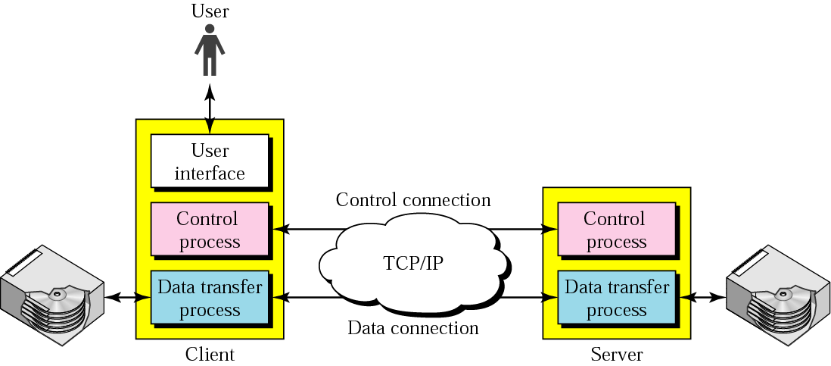
Figure 26.12 FTP
편리하고 예쁘게!

Slide 28
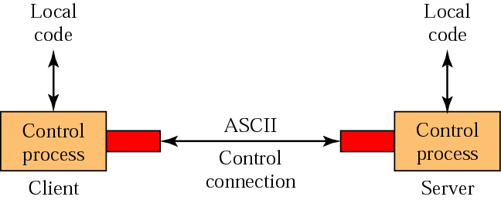
Figure 26.13 Using the control connection
pwd
200 OK

Slide 29
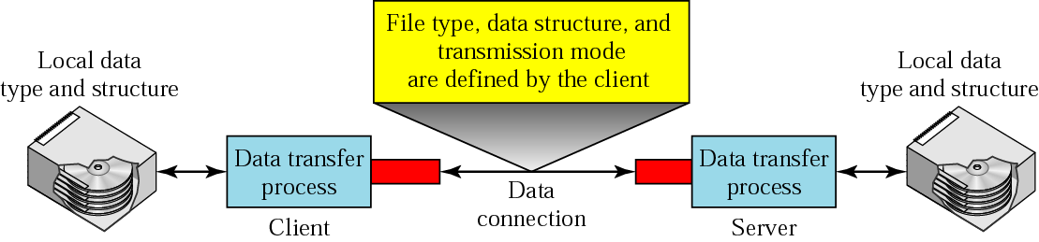
Figure 26.14 Using the data connection
get starcraft.zip
200 OK
Data

Slide 30
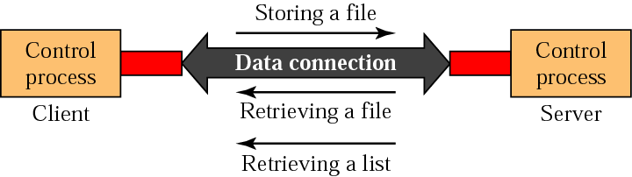
Figure 26.15 File transfer

Slide 31
Example 1
Figure 26.16 (next slide) shows an example of how a file is stored.
The control connection is created, and several control commands and responses are exchanged.
Data are transferred record by record.
A few commands and responses are exchanged to close the connection.

Slide 32
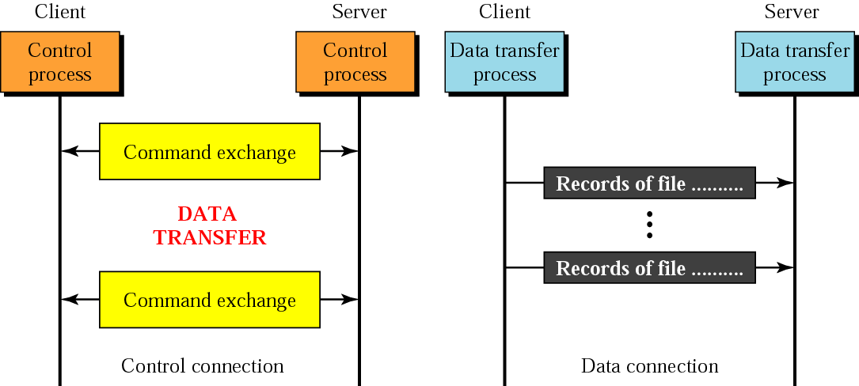
Figure 26.16 Example 1

Slide 33
Table 26.4 List of FTP commands in UNIX
Commands
!, $, account, append, ascii, bell, binary, bye, case, cd, cdup, close, cr, delete, debug, dir, discount, form, get, glob, hash, help, lcd, ls, macdef, mdelete, mdir, mget, mkdir, mls, mode, mput, nmap, ntrans, open, prompt, proxy, sendport, put, pwd, quit, quote, recv, remotehelp, rename, reset, rmdir, runique, send, status, struct, sunique, tenex, trace, type, user, verbose,?

Slide 34
Example 2
We show some of the user interface commands that accomplish the same task as in Example 1. The user input is shown in boldface. As shown below, some of the commands are provided automatically by the interface. The user receives a prompt and provides only the arguments.
$ ftp challenger.atc.fhda.edu
Connected to challenger.atc.fhda.edu
220 Server ready
Name: forouzan
Password: xxxxxxx
ftp > ls /usr/user/report
200 OK
150 Opening ASCII mode
...........
...........
226 transfer complete
ftp > close
221 Goodbye
ftp > quit

Slide 35
Example 3
We show an example of using anonymous FTP. We connect to internic.net, where we assume there are some public data available.
$ ftp internic.net
Connected to internic.net
220 Server ready
Name: anonymous
331 Guest login OK, send "guest" as password
Password: guest
ftp > pwd
257 '/' is current directory
ftp > ls
200 OK
150 Opening ASCII mode
bin
...
ftp > close
221 Goodbye
ftp > quit

